Slide 1

Recommended Practices for the Future Recruitment and Selection of Site Directors
Rural Church Summer Literacy Initiative
Winter Retreats
February 2025
Notes:
Kristen & Will

Slide 2
By the end of the session, pastors and church leaders will:
LEARNING OBJECTIVES
Be knowledgeable about recommended criteria for the future recruitment and selection of site directors.
Be familiar with available guidance and tips for improving the site director recruitment and selection process.
Notes:
Will

Slide 3

Criteria and guidance were developed by a set of experienced RC-SLP pastors and church leaders working with a member from each of the RC-SLI support and governance systems
Notes:
Will

Slide 4
By the end of the session, pastors and church leaders will:
LEARNING OBJECTIVES
Be knowledgeable about recommended criteria for the future recruitment and selection of site directors.
Be familiar with available guidance and tips for improving the site director recruitment and selection process.
Demonstrate the use of a worksheet to assess a potential/current site director’s strengths and developmental needs.
Have next steps for preparing their church to use the worksheet this spring.
Notes:
Will

Slide 5

Recommended Criteria
SITE DIRECTORS
Qualifications
Experience
Knowledge
Skills
Notes:
Will
Ask for willing examples from pastors and site directors from their module work
Something they thought they did well in summer 2024
Something they are hoping to “polish” in summer 2025

Slide 6
Qualifications
RECOMMENDED CRITERIA – SITE DIRECTORS
Required
Well-connected to the public education system
Passionate about children, literacy, and family
Appreciation of the faith-placed nature of the program
Current, valid NC teaching certificate*
  (for additional, preferred qualifications, see handout)
  *if expected to support in-classroom instruction
Notes:
Kristen
Preferred qualifications for strong candidates will also include a demonstrated commitment to lifelong learning and prior completion of trainings in Safe Sanctuaries, cultural humility, and trauma, toxic stress, and/or trauma-informed approaches to working with children and families.

Slide 7
Experience
RECOMMENDED CRITERIA – SITE DIRECTORS
Required
Working in public elementary education within the county or district of focus
Effectively managing behavioral issues with early elementary school children
Managing confidential data and information
Participating in the successful administration of sponsored programs
Supporting the implementation of organizational changes for improvement
Engaging with families of diverse cultural and social backgrounds
  (for additional, preferred experience, see handout)
Notes:
Kristen
Preferred experience for strong candidates will also include any number of the following:
creating a positive learning environment, including the use of activities that positively engage and reinforce early elementary students;
effectively working with students who are English language learners and/or families whose first language is not English;
providing literacy instruction in early elementary school settings;
team leadership;
providing professional development to team members through training, coaching, and/or mentoring;
having implemented policies and procedures commensurate with Safe Sanctuaries;
managing staff recruitment/hiring;
managing payroll; and
supporting and/or participating in data collection, including administering assessments.

Slide 8
Knowledge
RECOMMENDED CRITERIA – SITE DIRECTORS
Required
The dynamics and key players in the local public education system
How to create a positive learning environment
What makes an effective teacher
What makes an effective team member
Trauma, toxic stress, and/or trauma-informed approaches to working with children and families
Cultural humility
  (for additional, preferred knowledge, see handout)
Notes:
Will
Preferred knowledge for strong candidates will also include science of reading principles and practices; principles and practices for communicating with family and community members; and understanding church leadership roles and functions (for example, with regards to buildings, insurance, Safe Sanctuaries).

Slide 9
Skills
RECOMMENDED CRITERIA – SITE DIRECTORS
Required
Strong project management skills
Strong team building skills and the ability to support a positive team culture
The ability to work collaboratively with church leaders, program staff, families, and partner orgs
Strong behavior management skills with elementary school children
Strong family engagement skills
The ability to gather and use data, feedback, and other information for improvement
  (for additional, preferred skills, see handout)
Notes:
Will
Preferred skills for strong candidates will also include: the ability to learn from experience to succeed in new situations (learning agility); the ability to use creative media software platforms, such as Canva or similar; community event planning; and the ability to demonstrate cultural humility and trauma informed practices when working with students, families, and community partners.

Slide 10

Clarifying Questions?
Notes:
Will & Kristen

Slide 11
By the end of the session, pastors and church leaders will:
LEARNING OBJECTIVES
Be knowledgeable about recommended criteria for the future recruitment and selection of site directors.
Be familiar with available guidance and tips for improving the site director recruitment and selection process.
Demonstrate the use of a worksheet to assess a potential/current site director’s strengths and developmental needs.
Have next steps for preparing their church to use the worksheet this spring.
Notes:
Will

Slide 12
Guidance and Tips for Improving Your R/S Process
Getting Started
Communicating the Position
Form a hiring committee of at least three people (don’t leave it up to one person!)
Ensure everyone on the committee understands what is required to run RC-SLP effectively
Use the recommended criteria for recruiting and selecting site directors to set your selection criteria
Remember, this is a chance to communicate about your summer literacy program more broadly within the community
Visit your local public schools and other community schools during a teacher workday. Speak about the position and share the posting.
Advertise through local teachers’ organizations (e.g., local chapter of Delta Kappa Gamma Society)
Notes:
Kristen

Slide 13
Guidance and Tips for Improving Your R/S Process
The Initial Application Process
Candidate Interviews
Requested submission materials
Example application questions
Example interview questions
Consider an activity, such as a role play, that simulates a moderately challenging situation a site director might experience in your summer literacy program environment
Communicate key items clearly with candidates
When Interviews are Done
Reflect on interviews immediately
Ask references to share clear examples from observation of the candidate’s work
Use your assessment of the selected candidate for ongoing support!
Notes:
Will

Slide 14
Questions & Clarifications
Notes:
Will & Kristen

Slide 15

1-2-4-All
What is affirming?
What had you not considered before, but find intriguing?
What would you like to learn more about?
How can this information help you?
Notes:
Will & Kristen
Think - 7min;
Pair - 8min
Share in small group discussions (8min)
Large group report back - Criteria (popcorn answers for each question; 5min)

Slide 16
By the end of the session, pastors and church leaders will:
LEARNING OBJECTIVES
Be knowledgeable about recommended criteria for the future recruitment and selection of site directors.
Be familiar with available guidance and tips for improving the site director recruitment and selection process.
Demonstrate the use of a worksheet to assess a potential/current site director’s strengths and developmental needs.
Have next steps for preparing their church to use the worksheet this spring.
Notes:
Will

Slide 17
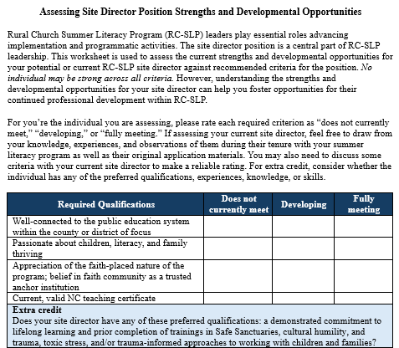
Strengths & Developmental Opportunities
ASSESSING THE SITE DIRECTOR POSITION
For use with:
  Candidates for your open position
  Current site director
Notes:
Will
Ask for willing examples from pastors and site directors from their module work
Something they thought they did well in summer 2024
Something they are hoping to “polish” in summer 2025

Slide 18

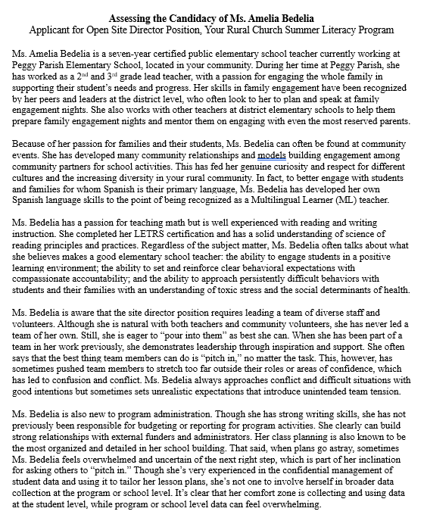
Ms. Amelia Bedelia
ASSESSING THE SITE DIRECTOR POSITION
Notes:
Will
Ask for willing examples from pastors and site directors from their module work
Something they thought they did well in summer 2024
Something they are hoping to “polish” in summer 2025

Slide 19
1-2-All
What might be “fully in place?”
What might be “developing?”
What might be “not in place?”
What would you like to learn more about with the candidate?
Notes:
Will & Kristen
Think - 15min
Pair - 8min
Large group report back – assessment (popcorn answers for each question; 5min)

Slide 20
By the end of the session, pastors and church leaders will:
LEARNING OBJECTIVES
Be knowledgeable about recommended criteria for the future recruitment and selection of site directors.
Be familiar with available guidance and tips for improving the site director recruitment and selection process.
Demonstrate the use of a worksheet to assess a potential/current site director’s strengths and developmental needs.
Have next steps for preparing their church to use the worksheet this spring.
Notes:
Will

Slide 21

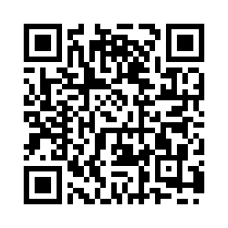
Who at your church is involved in the recruitment and selection of site directors?
Only 3 Questions!
Notes:
Will

Slide 22
Planning Next Steps
Ask: Use the Assessment this Spring
How will you go about sharing the information from today’s session with the church partners you listed?
How might you go about the assessment process for your current site director this spring?
As RC-SLI church leaders at your site, how could you use the results?
Notes:
Will
Pair - 10min
Ask everyone outline their first two steps when get home; popcorn report out (5min)

Slide 23
Next Steps
ASSESSING YOUR SITE DIRECTOR POSITION
Your assessment process – as scheduled by you!
Virtual Consultation* (March-May)
  Questions:
    Are site director recruitment/selection criteria clearer?
    How feasible are the criteria and guidance/tips to implement at your site?
  Debriefing the assessment results: what did you learn?
  Consultation on potential action steps for next cycle
    How might you use the results?
    How might we improve these resources?
*Virtual consultation will likely involve just your RC-SLI pastor and involved church leader(s)
Notes:
Will

